Slide 1

Decentralized ID Checklist for US Healthcare
Companion Guide
University of St. Gallen | Columbia Business School
© Sophia Maite Magdalena Goeppinger
sophia.goeppinger@student.unisg.ch | sgoeppinger23@gsb.columbia.edu

Slide 2
Executive Summary
The Problem
The US healthcare system is awash in a sea of data. To ensure efficient operation of the healthcare system, the vast amount of data generated every second – from clinical and reimbursement data to product information – must be easily accessible, editable, and trustworthy. However, current data flows are disrupted, including malicious attacks, preventing this from being fully achieved.
The Cause
The primary culprits of disrupted data flows are conflicting interests and incentives among healthcare stakeholders and the lack of digitization of trustworthiness to transmit it across all types of communication channels between interacting stakeholders.
The Solution
Conflicting interests and incentives are predominantly driven by the pursuit of financial gains rather than technical complexities. Conversely, the cardinal problem of transmitting trustworthiness across distance can be deciphered technically with decentralized identity (ID). Decentralized ID has begun to garner attention as a bulwark in the forthcoming generative AI era.
The Point of the Decentralized ID Checklist
Healthcare has a track record of failures in health information systems (IS) deployments: Health IS is touted as a solution to some of healthcare’s most pressing issues, but a significant percentage of such deployments fail.
Increase the likelihood of success: The framework is intended to assist in evaluating whether a healthcare use case is amenable to decentralized ID before proceeding with any investments. This enables you to make informed decisions when selecting use cases for decentralized ID and planning corresponding initiatives.
Evidence-based framework: The framework has been developed from theory and extensive primary research.
Initial framework applicability test: A precursor to the full assessment
This is a preliminary test to gauge if the framework suits your organization’s specific use case. A single “yes” justifies a more thorough exploration of the framework.
 | Yes | No
You face identification, authentication, and/or authorization issues when interacting with external stakeholders.
You face data quality issues when interacting with external stakeholders.
You face security/compliance issues when interacting with external stakeholders.

Slide 3
1 How to Use the Decentralized ID Checklist
Primary purpose: The Decentralized ID Checklist aids US healthcare stakeholders facing digital trust challenges that require resolution and already have a specific use case in mind that decentralized ID may address in assessing whether a particular use case is appropriate for decentralized ID. In this context, it is crucial to note that the framework examines decentralized ID as a concept and does not concentrate on specific implementation solutions.
Domain-crossing framework design: Decentralized ID is a multifaceted concept that extends beyond mere technology, encompassing legal, social, and business domains. The assessment model has been crafted using a domain-crossing approach to capture this multidisciplinary nature.
Within-organization target group: The design of the framework allows your organization’s tech and commercial divisions to collaborate on the framework independently, as the technical and market-specific aspects are separated. Upon completion, the assessment’s results may guide discussions with the C-suite, followed by approaching external key healthcare stakeholders whose participation is required to address the use case.
Second-order uses of the framework:
Expectation management tool: Deepens the practitioners’ understanding of decentralized ID and the underlying technologies as the driving forces behind this novel class of IS. By providing an overview of the capabilities and limitations of decentralized ID, it has the potential to deter opportunistic adopters from jumping on the bandwagon, hailing it as a panacea for every problem.
Legitimacy provision: Empowers your organization and managers to walk away from adopting a decentralized ID system before expending resources or devoting additional time to implementation planning.
Implementation support tool: Facilitates more informed decision-making in planning corresponding endeavors
Post-adoption project evaluation: Facilitates explaining potential project failures retrospectively.
Building blocks provision for context-specific needs: While the framework has been developed based on the problems of the US healthcare system, its modular nature allows it to apply to other national healthcare systems and entirely different sectors with some smaller or larger modifications, depending on the sector.
2 Structure of the Framework
The Decentralized ID Checklist is divided into a preparatory stage and two tiers, the “critical amenability assessment” and “comprehensive amenability assessment.” According to the theoretical proposition, the higher (lower) the degree of the six amenability dimensions for a use case, the more (less) amenable that use case is to decentralized ID. Tier I evaluates whether applying decentralized ID for a certain use case is appropriate solely based on theoretical effectiveness. Tier II considers contextual and situational factors, acknowledging that although a socio-technological innovation might seem promising in theory, practical challenges may emerge during its implementation (Flessa & Huebner, 2021).

Slide 4
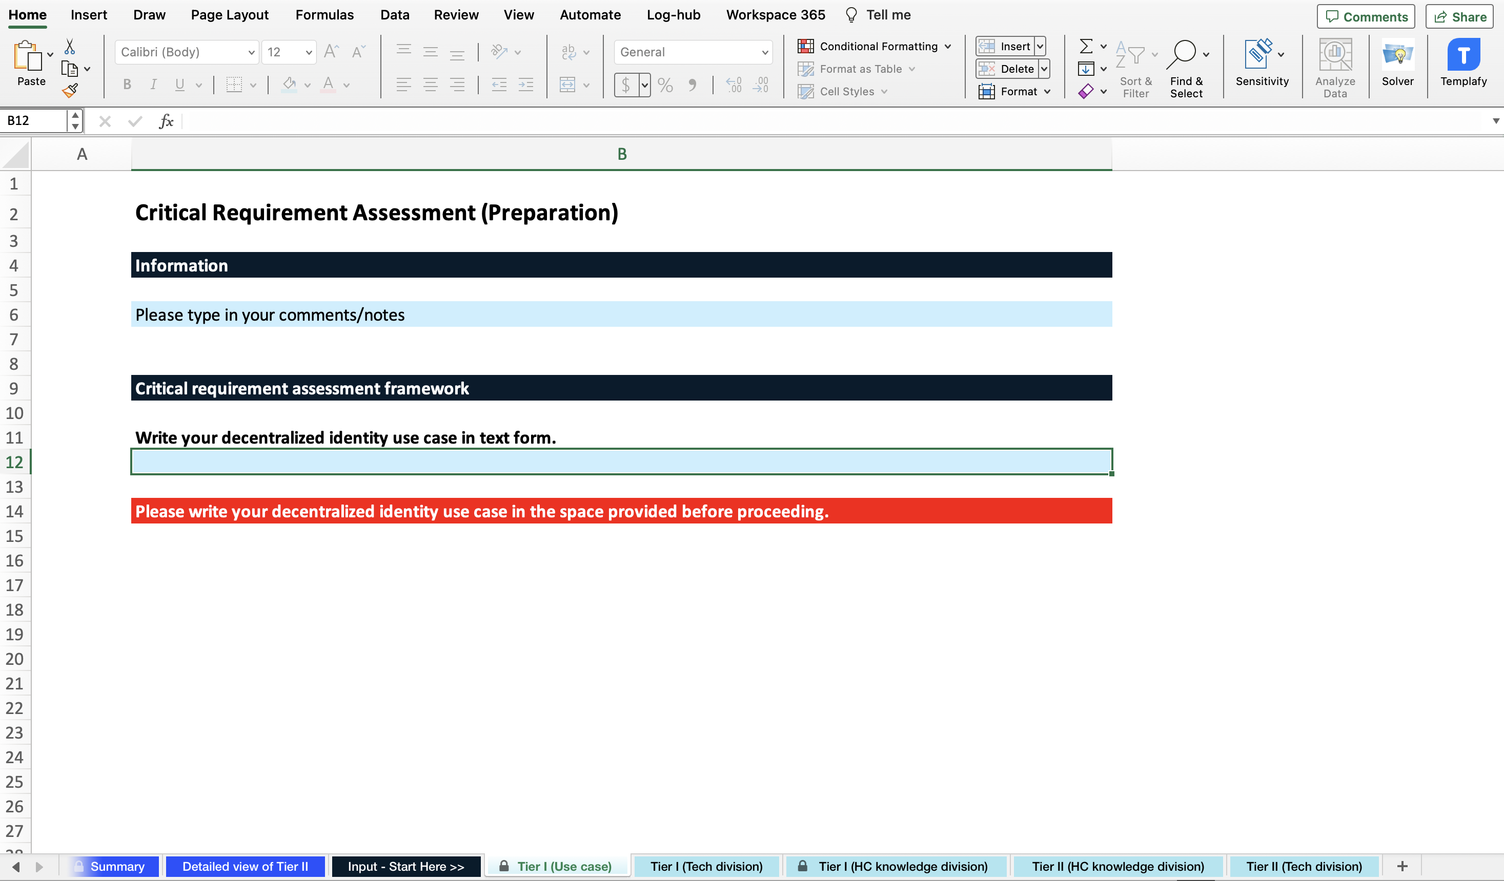
The division into two tiers offers an early assessment exit point. If Tier I yields negative results, it is not recommended to advance to the deeper use case evaluation of Tier II. The words in italics are specified in the glossary in Section 5 of this companion guide. Further details on the preparatory stage and the two tiers are provided below.
Before evaluating the two tiers, identify at least two individuals who work in the technology and commercial divisions of your organization, respectively. If a single individual or team rides the fence between these two divisions and can answer all the questions, that is wonderful. However, in many cases, it will be an information technology (IT) leader and a commercial leader with healthcare market knowledge. Have each leader complete their respective section, and you will have a comprehensive picture of whether your use case is amenable to decentralized ID.
Preparation
Open the enclosed Excel spreadsheet and begin drafting the use case in a clear and concise textual format. This will allow for the clear specification of any assumptions and facilitate the completion of the framework.
One of the recommended templates is provided by Cockburn (2001). Use cases, according to this template, can range from simple to highly detailed. Which style to use depends on various factors, such as your familiarity with the domain and writing use cases, stakeholder needs, and available resources to write a use case. Regardless of whether it is a simple or detailed version, each use case should include the concepts of scope (referring to the system being discussed), primary actor(s)/end-user(s) (referring to the end-user of the potential decentralized ID solution), and goal level (indicating the appropriate level of goal to be described, considering that many goals often contain sub-goals). Additional components that can be included in the use case description are, for instance, a list of stakeholders who have a vested interest in the goal but are not directly involved in the actions leading to it, main success scenarios that outline the process where nothing goes wrong, and potential issues or scenarios that differ from the main success scenarios.
Exemplary use case description
Use case: Facilitate medication prescriptions
Primary actor(s)/end-user(s): Physician, State Board of New York
Scope: Prescription process
Level: Summary (i.e., the entire prescription process is looked at and not just one single part of it)
Description: A board-certified physician practicing in New York writes daily prescriptions for his patients. To enhance accountability and verifiability in the prescription process, he desires a digital credential from the State Board of New York that confirms his certification to practice medicine in the state. The digital certificate enables attachment to the prescription, allowing the nearby pharmacy to verify his prescription writing privileges.

Slide 5
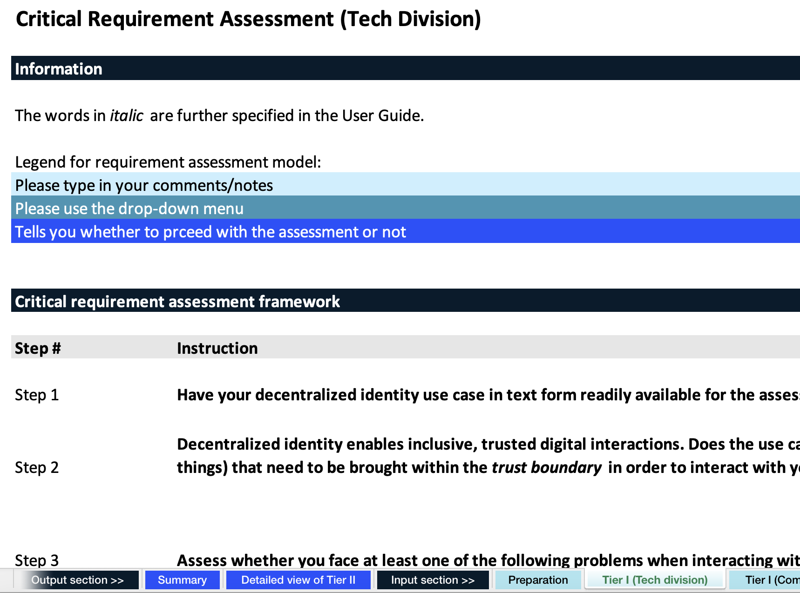
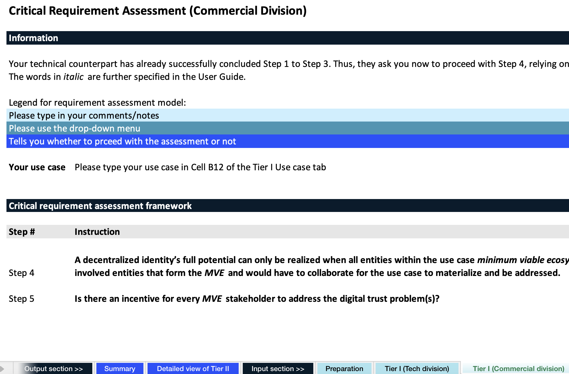
Tier I: Critical amenability assessment
Tier I assesses the appropriateness of decentralized ID to address the use case from a purpose-centric standpoint while omitting contextual factors.
With the drafted use case in hand, follow each step as indicated in the Excel spreadsheet. Since Tier I begins with technical aspects, it is recommended that the Tech Division initiates Tier I. The Tech Division should start by determining if the use case involves healthcare stakeholders that must provide you with some proof of trustworthiness, such as certifications or the HIPAA Business Associate Agreement (BAA), to initiate an interaction with them. If this condition is met, proceed to identify whether there are any digital interaction issues involved in the use case. Here, only one of the four problem sections must be designated as problematic for the assessment to proceed.
Upon completion of assessing the digital trust problems of the use case, hand the framework over to the commercial counterparts. The assessment requires them to list all healthcare stakeholders that would have to get involved for the use case to materialize, i.e., the minimum viable ecosystem (MVE). This is followed by the final step of the assessment framework, which involves analyzing whether all of these listed healthcare stakeholders have an incentive to address the digital trust problems of the use case. This last step determines if you should proceed to Tier II of the Decentralized ID Checklist for a more comprehensive evaluation by considering contextual factors.
Tier II: Comprehensive amenability assessment
Tier II, the comprehensive amenability assessment, assesses the amenability of a use case to decentralized ID deployment through a weighted decision matrix that takes into account contextual factors. Based on the overall alignment level between decentralized ID amenability factors (AFs) and the use case characteristics, it will be determined if the use case is amenable to decentralized ID solutions. Simply follow the navigation guidelines provided in the Excel spreadsheet.

Slide 6
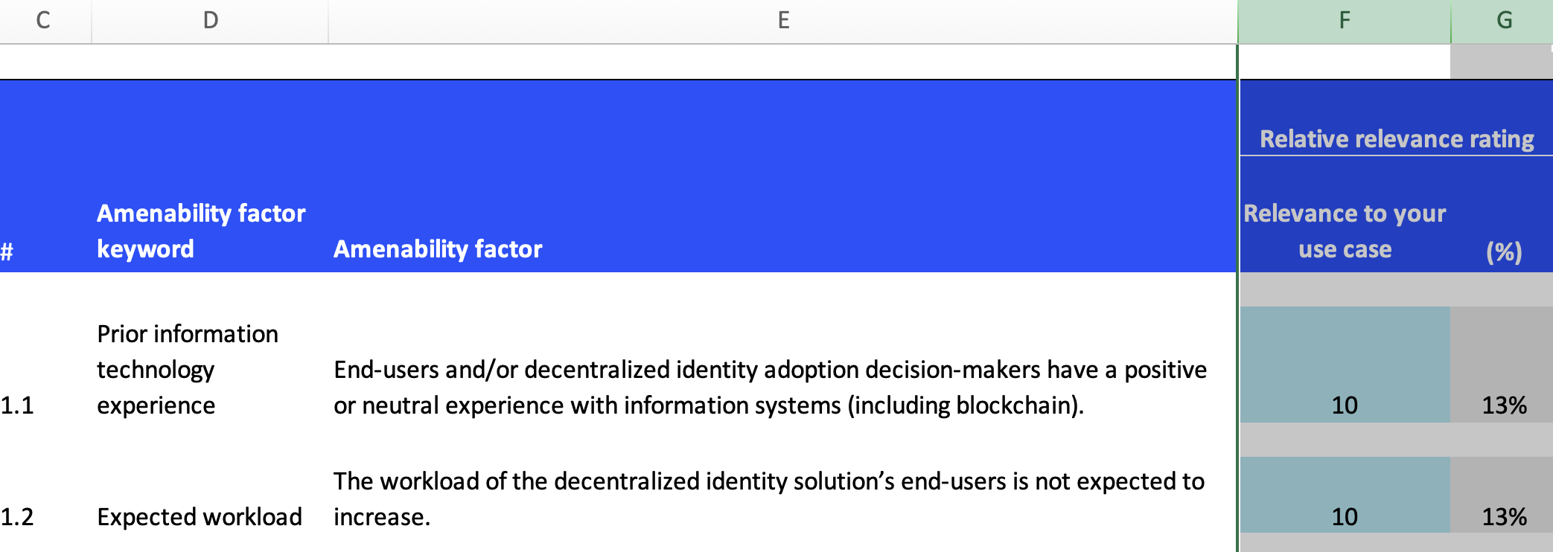
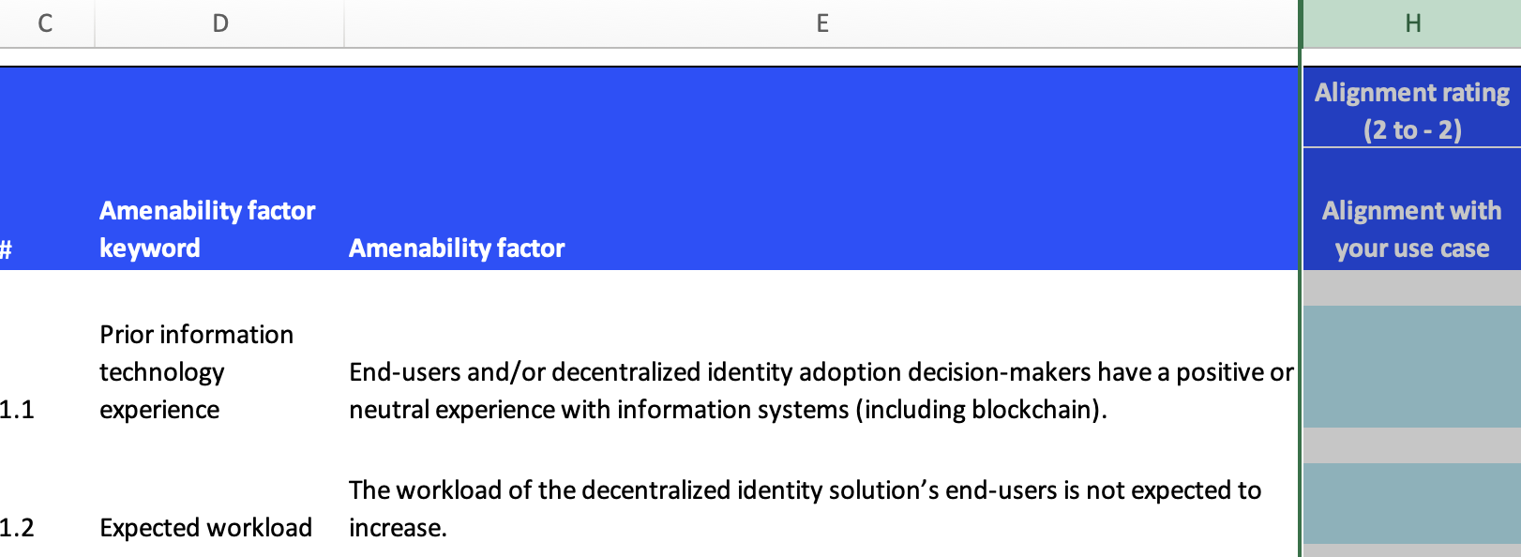
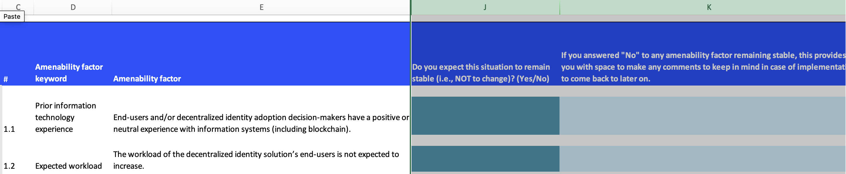
To calculate the overall amenability score, both divisions are expected to follow these steps:
Assign a relative importance rating to each item from each of the six amenability dimensions (human, organizational, technological, systemic, wider macro-economic, and collaborative use case characteristics) based on your best judgment regarding its relevance to the use case’s manifestation and handling. Begin by rating the first item (Column F) as “10” and then rate subsequent items accordingly. For instance, if an item holds the same level of importance, rate it as “10”. However, if it’s less significant, rate it as a lower number, such as a “7”. On the other hand, if it’s more crucial, rate it higher, such as a “40”. The default rating for all statements is “10”, giving you the flexibility to adjust its significance. Column G automatically displays the importance rating as a percentage.
Next, each AF is evaluated on how well it corresponds to the particular use case. In Column H, go through the statements from top to bottom and rate each based on how well it aligns with your use case at hand (-2 = strongly misaligns, -1 = somewhat misaligns, 0 = neutral, 1 = somewhat aligns, 2 = strongly aligns). The rating scale assumes higher values indicate higher amenability of decentralized ID to the use case.
It is critical to consider potential changes to the importance level and rating of each AF in the future. In Column J, indicate whether you expect the situation described in each AF to change to the best of your judgment. If you anticipate any changes, use Column K to write any comments on how you believe these will occur.
Steps 1 to 3 are followed by both the Tech Division and Commercial Division in their respective Excel tabs, as indicated. Some managers may have concerns about quantifying such a subjective and qualitative process. Nevertheless, quantification of some form can aid in revealing and examining underlying assumptions regarding the implementation of decentralized ID, particularly in the early stages of such a potential undertaking (Cummings and Holmberg, 2012).

Slide 7
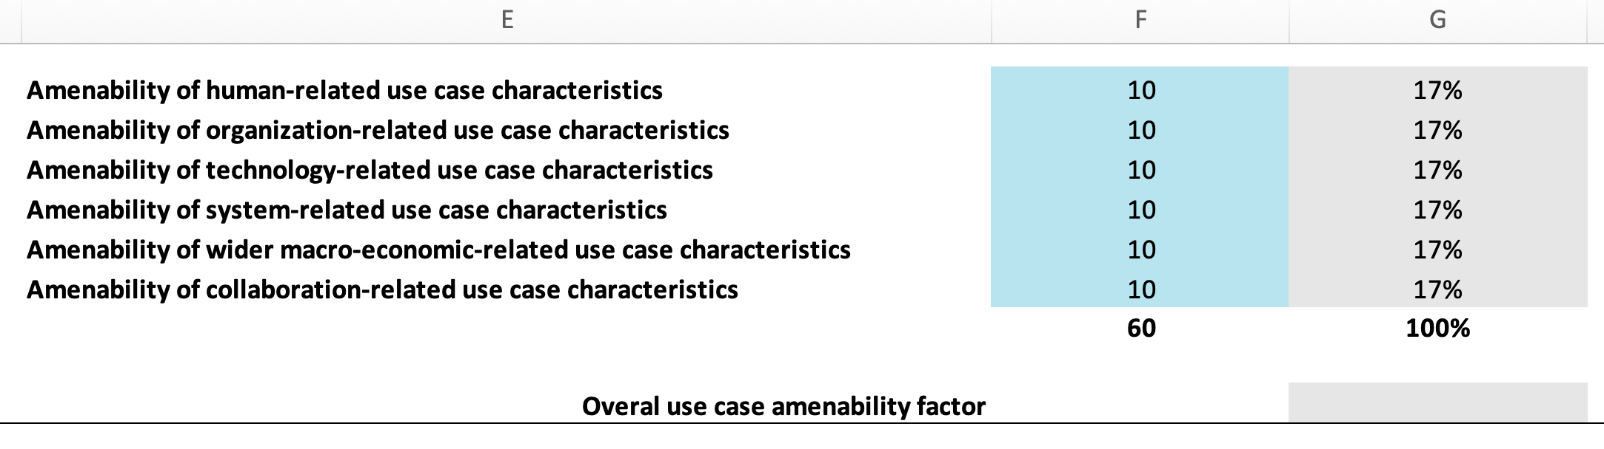
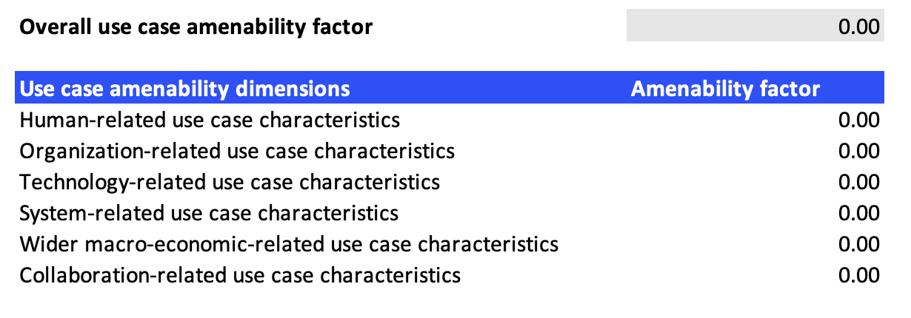
Finally, in the “Detailed view of Tier II” tab, both the Tech Division and Commercial Division jointly rate the amenability of each use case characteristics dimension according to its relative importance at the very bottom. This process is similar to the importance weighting of the various AFs: Begin by rating the “amenability of human-related use case characteristics” as a “10” and then rate subsequent dimensions accordingly. Again, Excel converts these numbers into percentages in the background so that all of the amenability dimensions total 100%. Upon completion of this step, an overall use case amenability factor results. Following the theoretical proposition, a final factor above 1 indicates an amplification of a use case’s amenability, while a final factor below 1 suggests a reduction in a use case’s amenability to decentralized ID.
Upon completing Tiers I and II, you may proceed to the “Summary” section to view the overall use case amenability score, including its breakdown into the six dimensions visualized in an amenability summary chart. That section’s information will provide a basis for follow-up discussions with your C-suite and other MVE stakeholders you might approach in the subsequent steps. To get a comprehensive overview of Tier II, including technology and market statements, visit the “Detailed view of Tier II” tab located next to the “Summary” tab. Red highlighted cells signify either the top 10% statements of critical importance or the statements that you gave a rating of -1 or lower, requiring extra attention during implementation.
Exemplary amenability summary chart

Slide 8
3 Assessment Framework Overview
Preparatory step
Tier I: Critical amenability assessment
Tier II: Comprehensive amenability assessment

Slide 9
4 The Decentralized ID Checklist Toolkit Overview
The Decentralized ID Checklist toolkit comprises various components that will aid in your use case assessment and the potential launch of a decentralized ID implementation endeavor.
An analytical tool: The core tool in Excel format, designed to facilitate the population and final score calculation of the framework. The spreadsheet has two parts – input and output – with the latter summarizing and analyzing all the inputs and thus serving as a basis for further discussion with the C-suite and other internal and external stakeholders. Terms that are italicized are defined in the glossary (see Section 5).
A companion guide: This very document, intended to assist in navigating the framework.
A live resource wiki: A dynamic, i.e., live document, hosted on GitHub. It offers supplementary resources to assist in addressing Tier II questions and provide a jumpstart for potential implementation. You can find the live resource wiki here.
5 Glossary
Actor | Decentralized ID is not limited to individuals but extends to actors, including for-profit and not-for-profit organizations, federal agencies, objects, and anything else requiring identification in the physical or digital world.
Amenability | The likelihood of the successful deployment (i.e., system-wide adoption and value-adding use) of decentralized ID in the US healthcare system.
Deployment | The umbrella term for technology adoption and use. The term “use” is to be understood as synonymous with “implementation.” Thus, deployment encompasses the entire innovation adoption process from the adoption decision to implementation, which involves integrating the technology into an actor’s operations to the extent that it is no longer novel. It is assumed that the scaling of the technology is a result of system-wide adoption and value-added use, with both acting as preconditions.
Decentralized ID | Decentralized ID refers to the concepts, ideas, architectures, processes, and technologies that enable inclusive, mutually trustworthy digital relationships that instigate power-structure changes and are collective-action- and network-dependent to reach their full potential.
Ecosystem | An ecosystem is defined by the alignment structures of the multilateral set of actors that need to interact in order for the use case to materialize and be addressed. Multilateral refers to the relationships between two actors that are themselves dependent on all other relationships within the ecosystem such that these relationships cannot be broken down into bilateral interactions. Although a set of actors implies the involvement of more than one actor, it does not necessarily mean that the set is complete and unchanging.
End-user | The individuals part of the US healthcare system that will interact with the decentralized identity solution(s).

Slide 10
Evidence | Past experiences, knowledge, policies, certifications and accreditations, computer configurations, and contracts such as the HIPAA Business Associate Agreement (BAA). Evidence is characterized along three dimensions. Within a given context, it needs to be sufficient, appropriate, and persuasive.
Minimum viable ecosystem (MVE) | Represents the minimum stakeholders and stakeholder groups necessary for the use case to materialize and be addressed. It serves as the catalyst for the joint endeavor, forming the foundation for further ecosystem development.
Relevance | The costs associated with the current way of verifying and proving ID, authenticity, authorization, and eligibility (01) and achieving use-case-appropriate data quality (02) in a secure, privacy-preserving, and regulatory-compliant manner (03). The nature of these costs can differ depending on the actor and use case and may encompass financial expenditures, time expended, and effect on user satisfaction, which ultimately affect the bottom line.
System-wide adoption | The achievement of perceived critical mass, which signifies the point at which the technology’s adoption reaches a self-sustainable level.
Trust | There are various definitions of trust, but for the purpose of this framework, the following definition is employed: “the willingness of a party to be vulnerable to the actions of another party based on the expectation that the other will perform a particular action important to the trustor, irrespective of the ability to monitor or control that other party” (Mayer et al., 1995, p. 712). While not explicitly accounted for in this definition, it is worth noting that trust involves vulnerability and inherent risk.
Trustworthiness | Can be understood as deserving of trust (Cambridge Dictionary).
Trust boundary | Characterizes the evidence that regulates interactions between you and other actors within the trust boundary. Within the trust boundary, the evidence is sufficient, appropriate, and persuasive enough for you to engage in trustworthy interactions with the evidence-providing actor (i.e., the other party(ies)). Actors on this side of the boundary are considered trustworthy. Beyond the trust boundary, the provided evidence is insufficient, inappropriate, and unpersuasive for you to engage in interactions with the evidence-providing actor. Actors on this side of the trust boundary are deemed untrustworthy. For a trustworthy digital interaction to happen, these actors need to be brought within the trust boundary through verifiable evidence. Even if the audit standards (i.e., the sufficiency, appropriateness, and persuasiveness of the evidence required and provided) are exceedingly high, trust is never anticipated to be zero unless the interaction is solely among non-human actors (i.e., things). This is because trust is still needed in the actors within the trust boundary to comply with the evidence provided. Establishing these trust boundaries can be economically costly. The trust boundary for a particular interaction, and thus your willingness to bear risk, is determined by four factors: (a) the context of the relationship, (b) the probability of the process failing, (c) your expected return, and (d) the cost you are willing to incur to mitigate risk and enhance confidence in the outcome. Given the dependence of trust on these multiple factors, these trust boundaries are in flux.

Slide 11
Use case | In general, use cases, as a form of writing, describe a set of actions that human and non-human actors need to perform jointly to achieve a certain goal. As these documents are typically read by non-technical individuals, they are often written in a textual format (Cockburn, 2001). Use cases are always named using verb phrases in the present tense. Prime examples of decentralized identity use cases in healthcare include Facilitate Medication Prescriptions, Prescribe Medication for Patients, Prove and Verify Identities and Insurance Coverage, Recruit Participants for Clinical Trials, and Prove and Verify Physician Credentials.
Value-adding use | The extent to which a technology is utilized within a specific context to maximize and harness its full potential.
6 References
Cambridge Dictionary. Trustworthy. Retrieved November 26 from https://dictionary.cambridge.org/dictionary/english/trustworthy
Cockburn, A. (2001). Writing effective use cases. Addison-Wesley.
Cummings, J. L., & Holmberg, S. R. (2012). Best-fit alliance partners: The use of critical success factors in a comprehensive partner selection process Long Range Planning, 45(2-3), 136-159. https://doi.org/10.1016/j.lrp.2012.01.001
Flessa, S., & Huebner, C. (2021). Innovations in Health Care—A Conceptual Framework International Journal of Environmental Research and Public Health, 18(19), 10026. https://doi.org/10.3390/ijerph181910026
Mayer, R. C., Davis, J. H., & Schoorman, F. D. (1995). An integrative model of organizational trust. The Academy of Management Review, 20(3), 709-734.

